Slide 1

Customer Shopping Behavior Analysis
Uncovering insights from 3,900 transactions across product categories — spending patterns, customer segments, and strategic opportunities.

Slide 2
Dataset at a Glance
3,900
18
Transactions
Columns
Rows in the dataset
Features tracked
37
$59.76
Missing Values
Avg Purchase
In Review Rating only
Mean transaction value
Customer Demographics
Purchase & Behavior
Age, Gender, Location, Subscription Status
Item, Category, Amount, Season, Discount, Frequency, Review Rating, Shipping Type

Slide 3


Data Preparation in Python
Clean & Standardize
Feature Engineering
Imputed missing Review Ratings using category medians; renamed columns to snake_case.
Created age_group bins and purchase_frequency_days columns.
Database Integration
Loaded cleaned DataFrame into PostgreSQL for SQL analysis.

Slide 4

Revenue by Gender
Male Customers
$157,890 total revenue — more than double female contribution
Female Customers
$75,191 total revenue
Male customers account for the majority of total revenue, representing a significant opportunity for targeted engagement strategies.

Slide 5
Product & Discount Insights
Top 5 Products by Rating
Highest Discount Rates
Product
Avg Rating
Product
Discount %
Gloves
3.86
Hat
50.00%
Sandals
3.84
Sneakers
49.66%
Boots
3.82
Coat
49.07%
Hat
3.80
Sweater
48.17%
Skirt
3.78
Pants
47.37%
839 customers used discounts yet spent above average — discount users are high-value buyers.

Slide 6
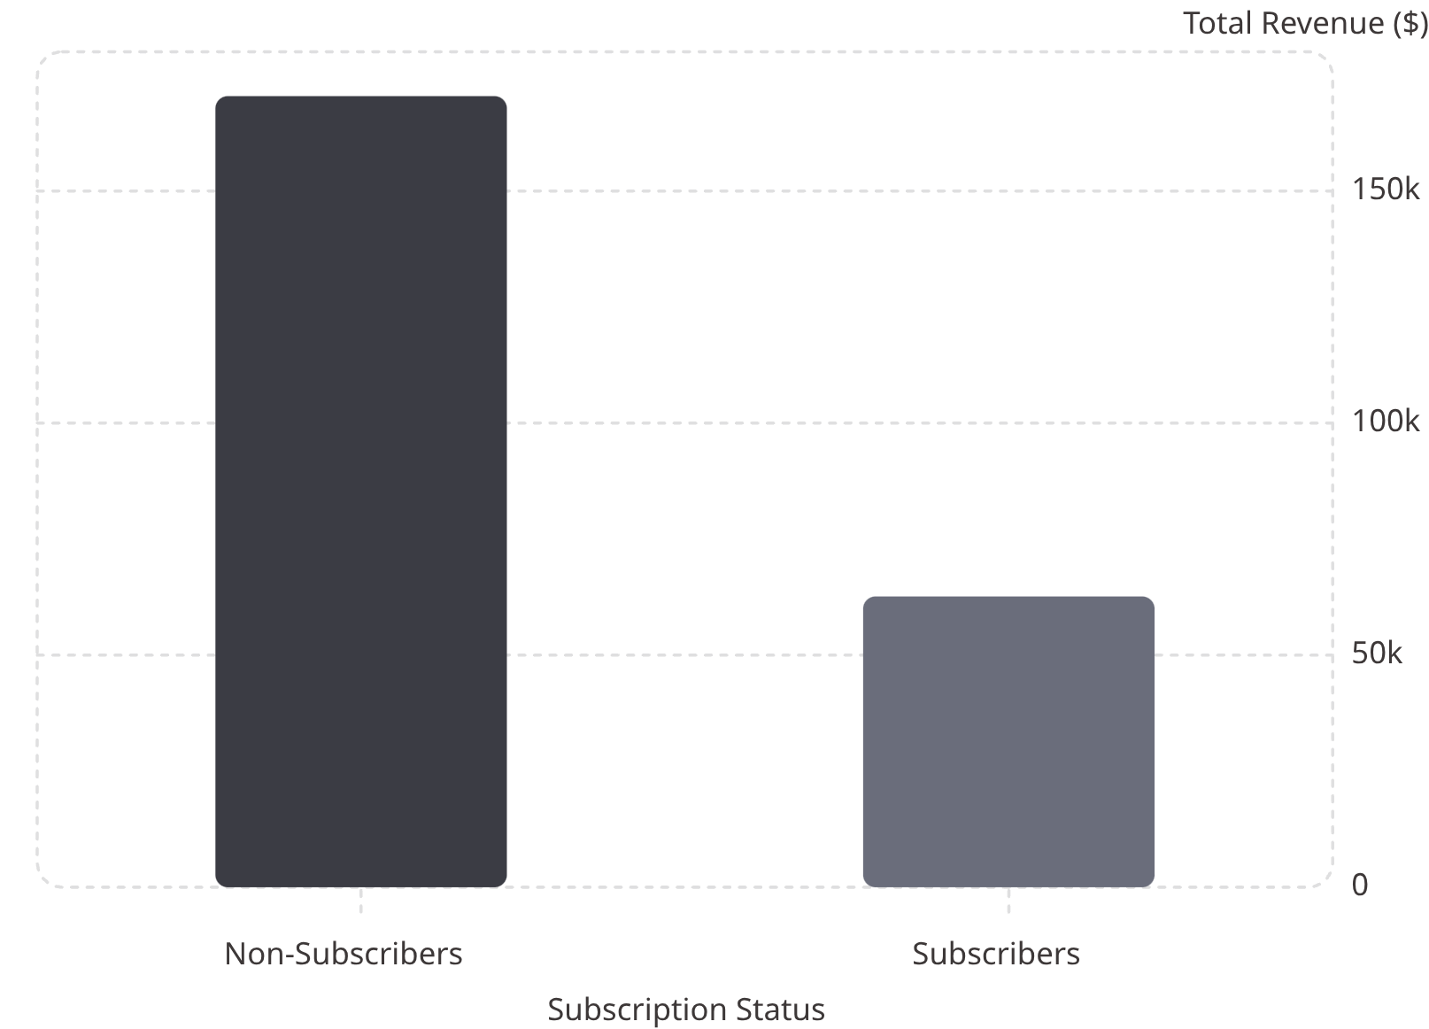
Subscription & Shipping Behavior
Subscribers vs. Non-Subscribers
Non-subscribers drive 73% of customers and $170K in revenue. Subscribers (27%) average $59.49 spend vs. $59.87 for non-subscribers — nearly identical.
Shipping Type Impact
Express shipping averages $60.48 vs. $58.46 for Standard — a modest but consistent premium.

Slide 7
Customer Segmentation
🏆 Loyal
🔄 Returning
🌱 New
3,116 customers — the dominant segment with strong purchase history
701 customers — potential to convert to loyal with the right incentives
83 customers — smallest segment, key growth opportunity
Of customers with more than 5 purchases, 958 are subscribers vs. 2,518 non-subscribers — repeat buyers show meaningful subscription uptake.

Slide 8
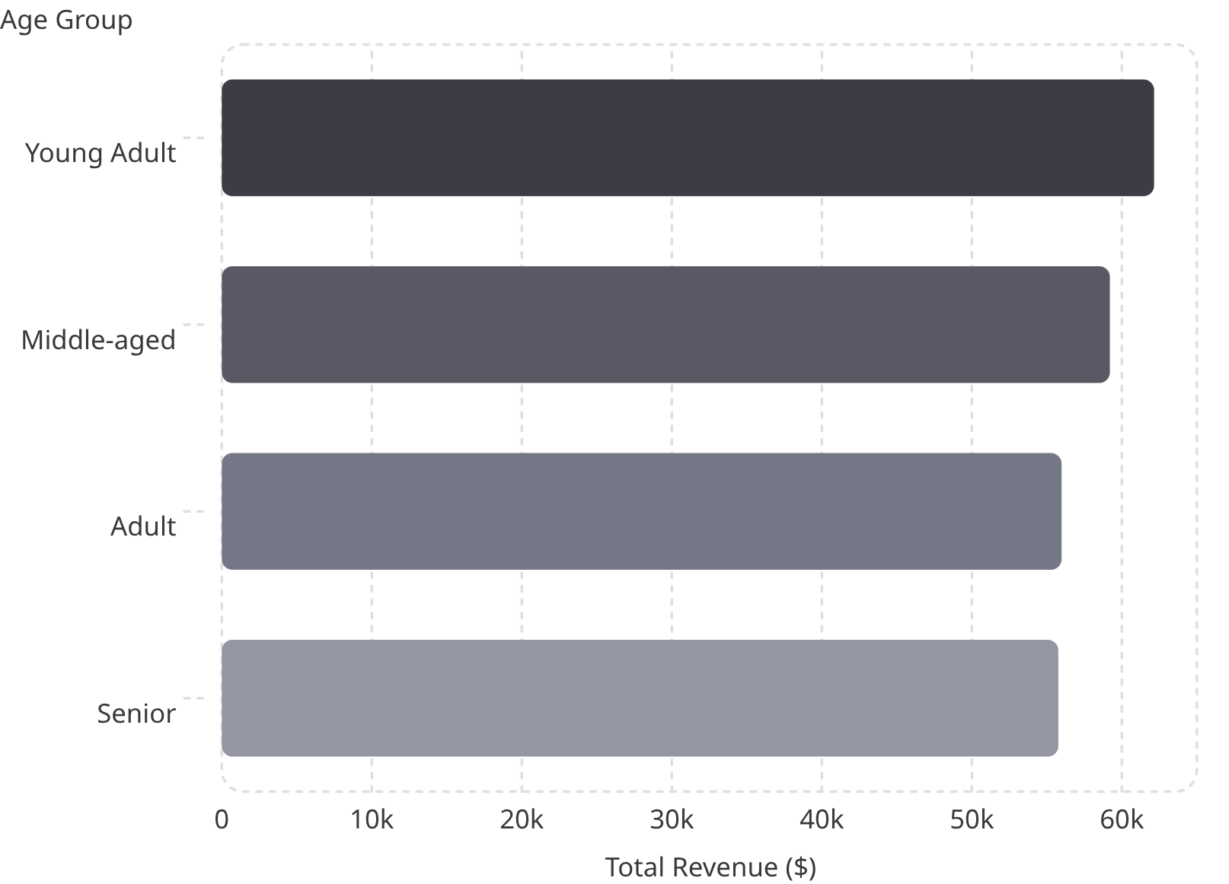

Revenue by Age Group
Key Takeaway
Young Adults lead revenue at $62,143, but all four age groups contribute relatively evenly — suggesting broad market appeal across demographics.
Revenue spread is within ~$6K across all groups, indicating no single age dependency.

Slide 9
Top Products by Category
1
2
Accessories
Clothing
Jewelry (171), Sunglasses (161), Belt (161)
Blouse (171), Pants (171), Shirt (169)
3
4
Footwear
Outerwear
Sandals (160), Shoes (150), Sneakers (145)
Jacket (163), Coat (161)
Clothing dominates with the highest order volumes, while Outerwear has the fewest top products listed.

Slide 10

Power BI Dashboard & Recommendations
Boost Subscriptions
Promote exclusive subscriber benefits to grow the 27% base.
Loyalty Programs
Reward repeat buyers to convert Returning customers into Loyal.
Review Discount Policy
Balance sales lift with margin control on high-discount products.
Targeted Marketing
Focus on high-revenue age groups and express-shipping users.

